Slide 1
Clotho: Saving Programs from Malformed Strings and Incorrect String-handling
Aritra Dhar, Xerox Research Centre India
Rahul Purandare, IIIT Delhi
Mohan Dhawan, IBM Research & IIIT Delhi
Suresh Rangaswamy, IIIT Delhi
ESEC/FSE 2015

Slide 2

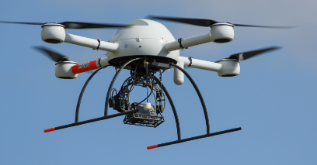


Software applications fail!
Air traffic control
The 1990 AT&T Long Distance Network Collapse
USS Yorktown, complete failure in propulsion and navigation in 1998
ATC LA Airport lost communication with all 400 airplanes
UAV
Telephone Networks
Notes:
Before going to the actual problem, I will first talk about the severity of software crashing in real life. All of you are aware of presence of software and automation in critical infrastructures such as ATC, telephone network, power grids, life support systems etc. Sudden crash in these systems may lead to catastrophic consequences which can cause loss of infrastructure, huge amount of money and in worst case human life. The crucial property all of these system share is availability. Sudden shutdown of such systems due to failures is not acceptable. But time to time we have seen failures in such systems. Explain the bullet points.

Slide 3
Observation
Large number of software use 3rd party libraries
Crash causes delay in product life cycle
Strings are heavily used
Source: An Analysis of Dependence on Third-party Libraries in Open Source and Proprietary Systems by Raemaekers et al.
Notes:
Now I show you some observations we encountered during our research. We went through several computer science discussion forums and open source bug library to understand the severity of program crashing in software products and how we can relate to it. One crucial fact is 3 rd party libraries. Software developers use these libraries extensively to leverage functionality. Any bug or vulnerability in such libraries will also reflect in the boat application. And the major problem is that we have no control over the source on such libraries. It's happened seldom that a developer actually makes some changes to the library code and recompile them. We know that crash is bad for business. Any major crash can significantly set the release cycle back to some undetermined amount of time. Which also causes delay in the next product release hence directly reflects to loss of revenue. From the paper we have found a statistics who h shows how many percentage of open source systems use 3rd party libraries. Moreover we also observed that several proprietary systems also share these open source libraries. Another observation we have is that a large number of software use String library extensively. Which is why we mostly concentrate on String related libraries.

Slide 4
Example
..
int prefix = prefixLength(filename);
int index = indexOfLastSeparator(filename);
int endIndex = index + separatorAdd; //separatorAdd is a parameter (=0)
return “”;
return filename.substring(prefix, index + separatorAdd);
if((prefix >= filename.length()) || (index < 0))
if((prefix >= filename.length()) || (index < 0) || (prefix > endIndex))
No boundary check
Input = /foo.txt
prefix = 1, index = 0
Result: IndexOutOfBoundExceptiom
Input = C:/p1/p2/foo.txt
prefix = 3, index = 8
Result: p1/p2
Apache Commons IOFileUtils bug; priority: major; affected versions: 1.3.2, 1.4; fixed: 2.0
Notes:
Before going to the actual details, let us discuss an important example. The following code snippet is a part of apache commons IO API source code.
Method getpathNoEndSeparator calls a private method named doGetPath with arguments filename and 0. The method prefixLength returns the length of the
prefix of a file path. indexOfLastSeparator returns the index of last separator encountered. The separator may be "/" or "\" based on OS.

Slide 5
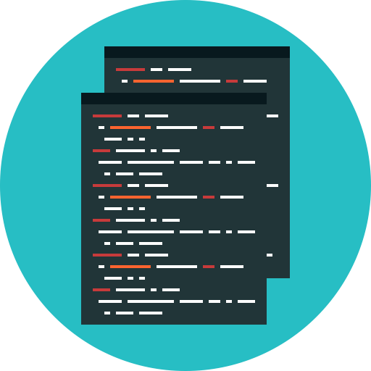

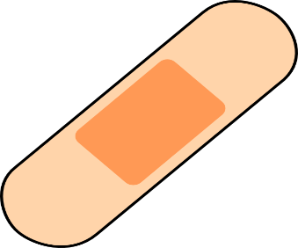

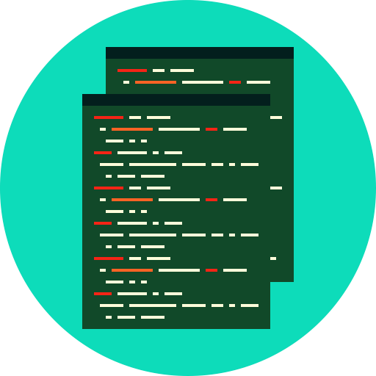








Problem Definition
1
2
$$ℐ$$
3
$$𝒫$$
$$ℬ$$
$$𝒫$$
$$𝒫′$$
$$ℐ$$
$$𝒫$$
1
2
3

Slide 6


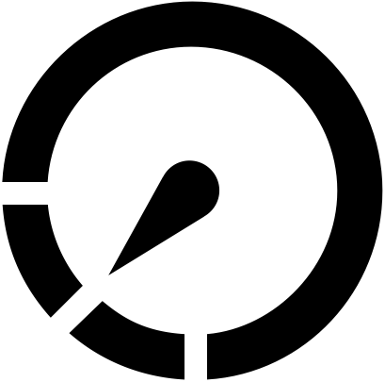
Problem Definition: Design Goals
High patch fidelity
Non-invasive patching
Low overhead
Notes:
High patch fidelity
Precise
Preserve intended program behavior
Non-invasive instrumentation
No side effect
Patch triggers only when crash is imminent
Low system overhead
None when no exception
Minimal incase patch triggers

Slide 7
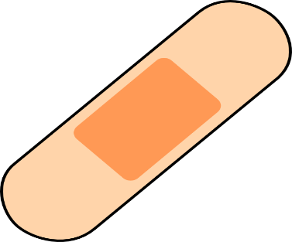
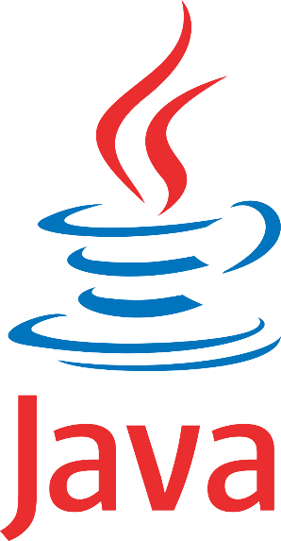
Challenges
Patched program should preserve core functionalities
Only Java byte code available
No source code

Slide 8
Outline
Motivation and Problem definition
CLOTHO design
Implementation
Evaluation
Conclusion

Slide 9
Clotho: Design
High patch fidelity
Non-invasive patching
Patches in catch blocks
Constraint Analysis
Find Program points for patching
Static
Dynamic
Optimize Instrumentation

Slide 10
Clotho: Design
Java byte code
Patching Module
Find program points for patching
Static constraint analysis
Run
Input program
Patching
Repaired program
Taint Analysis
Call graph analysis
Dynamic constraint analysis

Slide 11




Find Program Points for Patching
Taint Analysis
Statements on tainted path are excluded from pathing Data leaving the program are not patched
Flexibility of defining custom sources and sinks
Soot InfoFlow framework
Call Graph Analysis
Exclude already handled exception
Reverse BFS on call chain
$$g()$$
$$f()$$
$$b()$$
$$h()$$

Slide 12
Design : Patching Module
Constraint Analysis
Collection and evaluation
Static and dynamic constraints
Parameter Tweaking

Slide 13
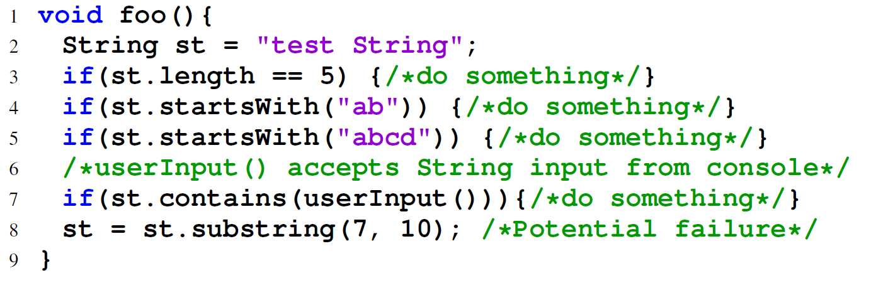
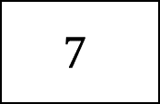
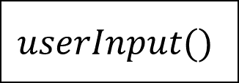
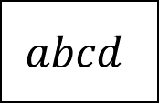
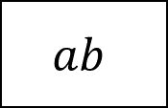
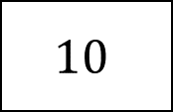
Constraint Collection
Possible prefixes
$$7$$
$$10$$
$$ab$$
$$abcd$$
$$userInput()$$
Possible max and min length
Possible string contains evaluated dynamically

Slide 14
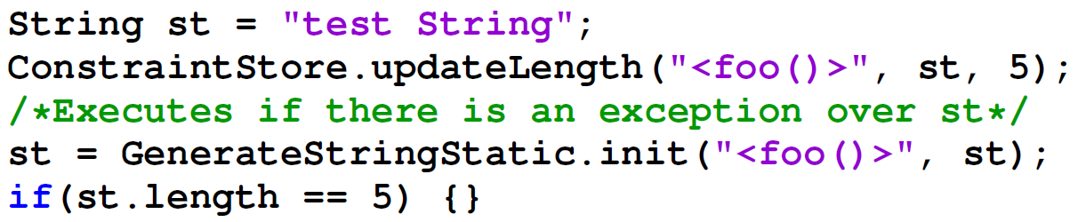
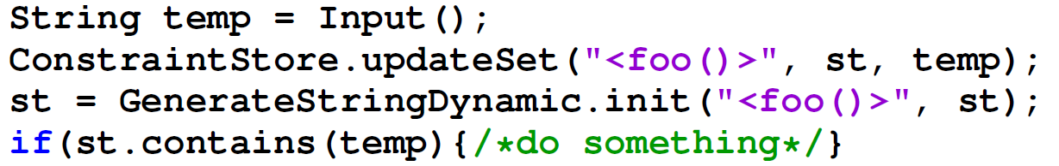
Constraint Collection & Evaluation
Static Constraints
Dynamic Constraints
try{ st = st.substring(7,10);
}catch(IndexOutOfBoundException ex){
//patch code}
Generate a new string object based on constraint data store

Slide 15
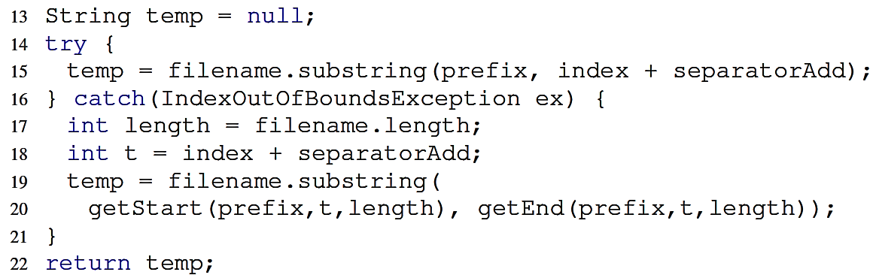
What if nothing works?
Parameter tweaking
Evaluate safe indices from string properties
Recall earlier example (Apache Commons IO)

Slide 16
Outline
Motivation and Problem definition
CLOTHO design
Implementation
Evaluation
Conclusion

Slide 17
Implementation
End-to-end repairing tool chain written in Java ~15KLOC.
Soot for byte code analysis and instrumentation.
Soot infoFlow for static taint analysis.
Optimizations
Minimize constraint analysis
Minimize patch instrumentation

Slide 18
Outline
Motivation and Problem definition
CLOTHO design
Implementation
Evaluation
Conclusion

Slide 19
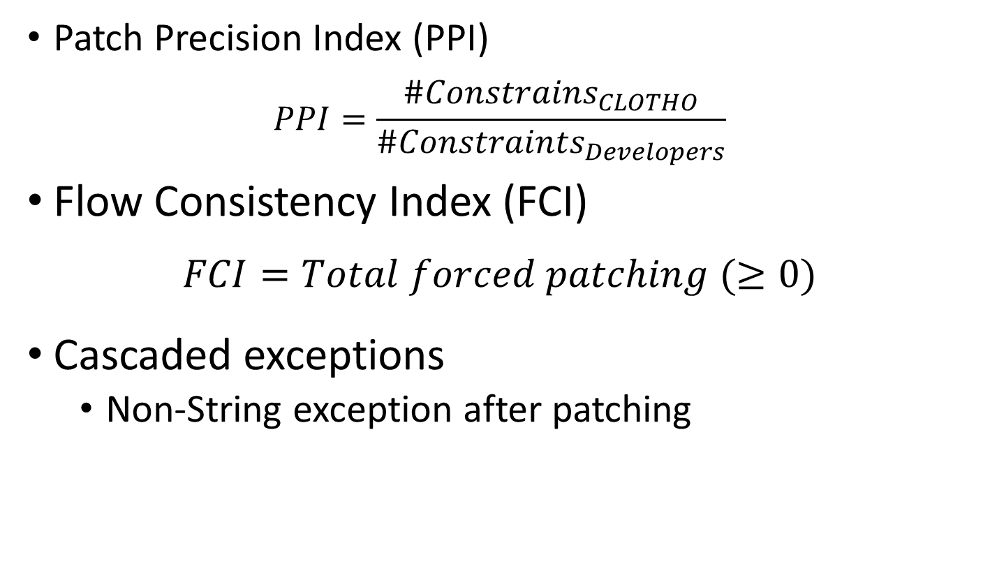
Evaluation metrics
Patch Precision Index (PPI)
$$PPI=\frac{\#Constrains_{CLOTHO}}{\#Constraints_{Developers}}$$
Flow Consistency Index (FCI)
$$FCI=Total forced patching (≥0)$$
Cascaded exceptions
Non-String exception after patching

Slide 20
Clotho Evaluation
30 bugs from open source libraries
Bug repositories of Apache, Eclipse projects
Test cases from library test suites

Slide 21
Clotho Evaluation

Slide 22
Clotho Evaluation

Slide 23
Clotho Evaluation: PPI

Slide 24
Clotho Evaluation: Optimization

Slide 25
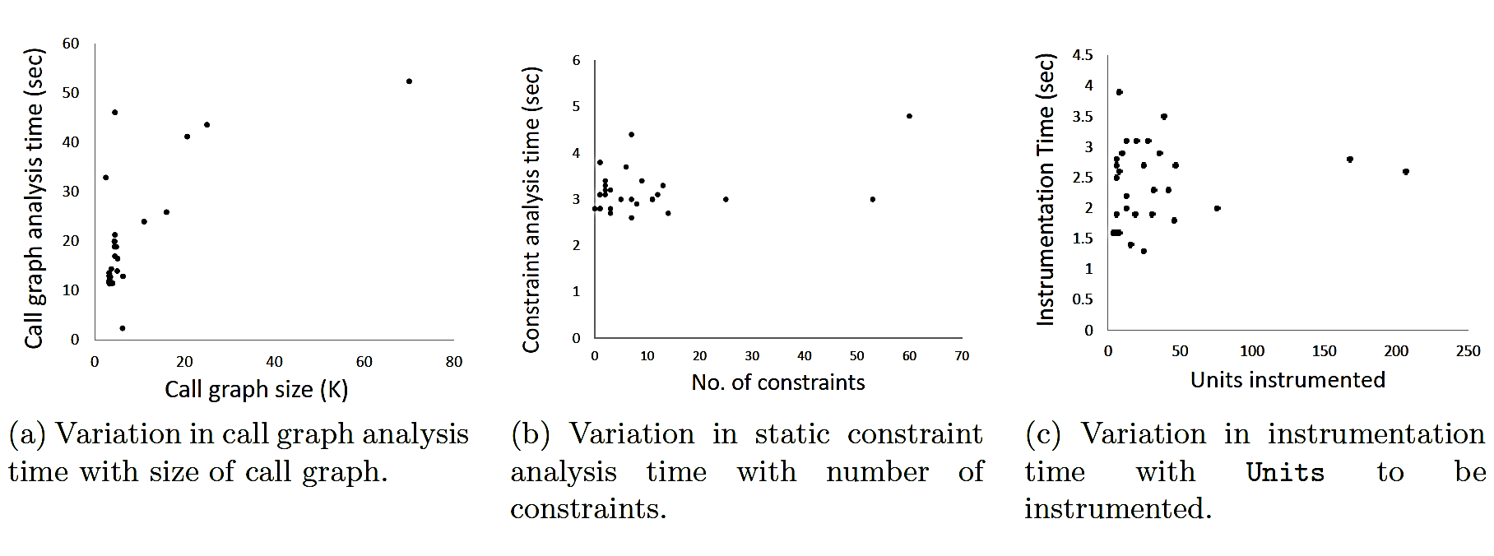
Clotho Performance

Slide 26
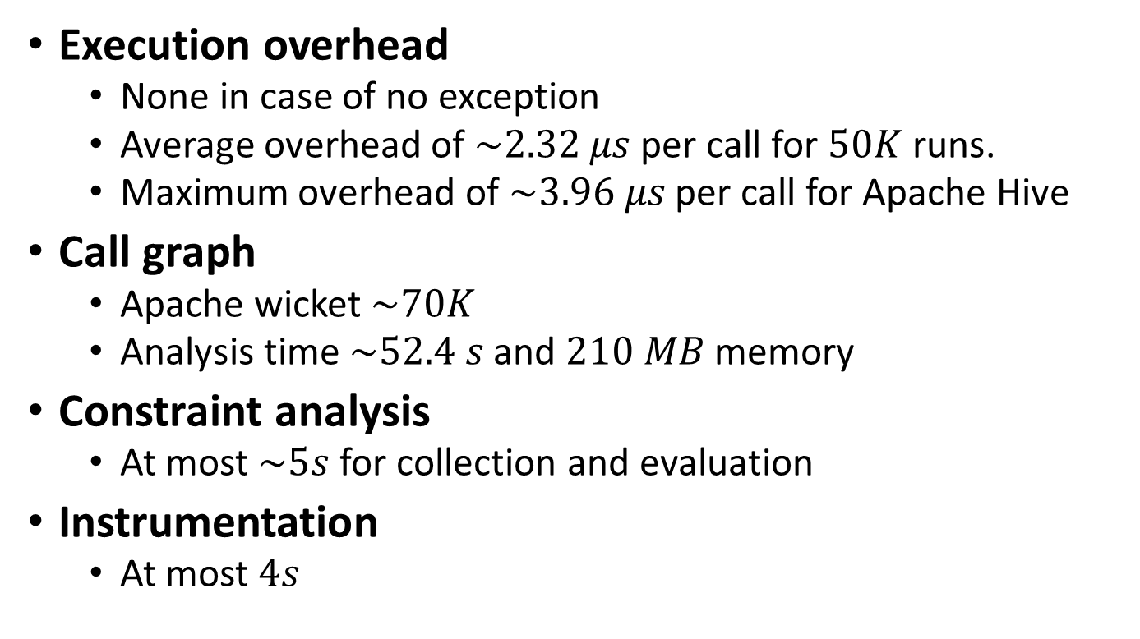
Clotho Overheads
Execution overhead
None in case of no exception
Average overhead of $\sim 2.32 μs$ per call for $50K$ runs.
Maximum overhead of $\sim 3.96 μs$ per call for Apache Hive
Call graph
Apache wicket $\sim 70K$
Analysis time $\sim 52.4 s$ and $210 MB$ memory
Constraint analysis
At most $\sim 5s$ for collection and evaluation
Instrumentation
At most $4s$

Slide 27
Outline
Motivation and Problem definition
CLOTHO design
Implementation
Evaluation
Conclusion

Slide 28
Conclusion & Future work
Hybrid program analysis framework for automated patch for Java program.
Targeted patching mechanism for Java String types
In most of the cases Clotho generates efficient patches.
Provides good baseline for future patch developments.
Adding more support for other Java APIs.
Adding more intelligence to patching mechanism for more effective patch.

Slide 29
Thank you
https://github.com/aritradhar/CLOTHO

Slide 30
Related Work
Cabin et al.(’11), Perkins et al.(’09) Dynamic approaches : memory, data, and incorrect programming constructs such as infinite loops
Demsky et al. (’03, ’05, ’06) Data structure repairing by isolating damaged data or memory portion
Eom et al.(’12) Delay execution till program self-stabilizes
Pezze et al.(’11) Find alternative execution paths
Long et al. (’14) Suppressing signals and attach lightweight monitors for divide by zero and null dereferencing errors
Cerny et al.(’14), Wei et al. (’10) develop patch and check correctness by computationally intensive techniques such as model-checking

Slide 31
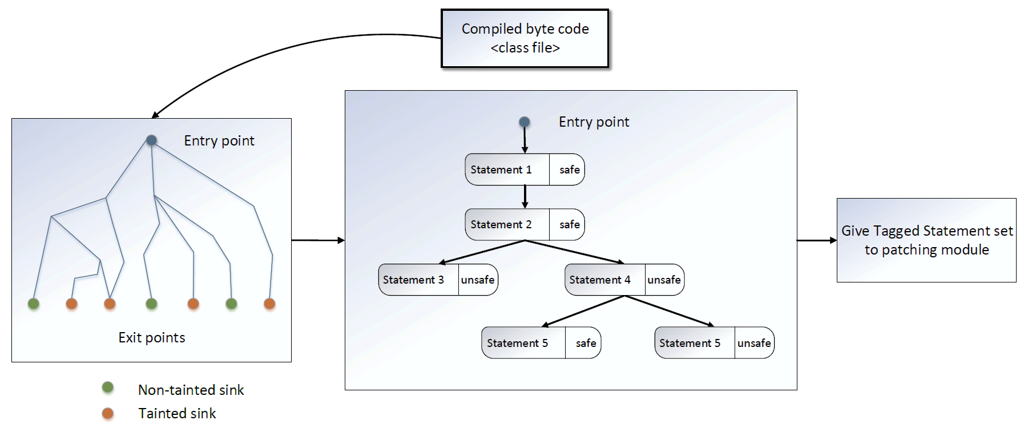
Taint Analysis

Slide 32
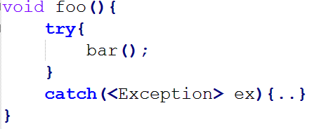
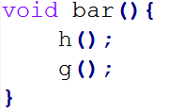


Call Graph Analysis
foo()
bar()
h()
g()
Look in the call sight of all the ancestors.
Reverse BFS.

Slide 33
Contribution
Novel hybrid technique for patch generation which ensures patch quality to be as per developers’ fix.
Fully automated open source end-to-end tool: Clotho.
Repairing solutions over 64+ String based API calls.
Promising results for popular 30 java 3rd party library bug.

Slide 34
Taint analysis precision

Slide 35
Problem Definition: Design Goals
1. High patch fidelity
Precise
Preserve intended program behavior
2. Non-invasive instrumentation
No side effect
Patch triggers only when crash is imminent
3. Low system overhead
None when no exception
Minimal incase patch triggers

Slide 36
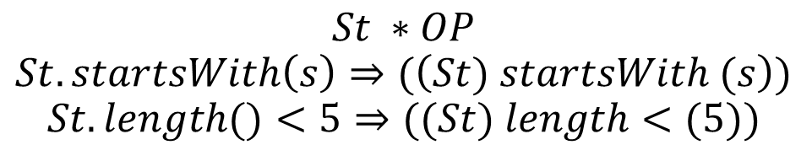
Constraint Collection : Constraint Data store
void foo(){
..
String str = “abc”;
if(s.startsWith(input()))
..
if(s.length < 5)
..
}
$$St ∗OP$$
$$St.startsWith\left(s\right)⇒(\left(St) startsWith (s\right))$$
$$St.length()<5⇒((St) length<(5))$$

Slide 37
Challenges
No access of source code: logic is unknown
Patching should not interfere natural flow of the program

Slide 38
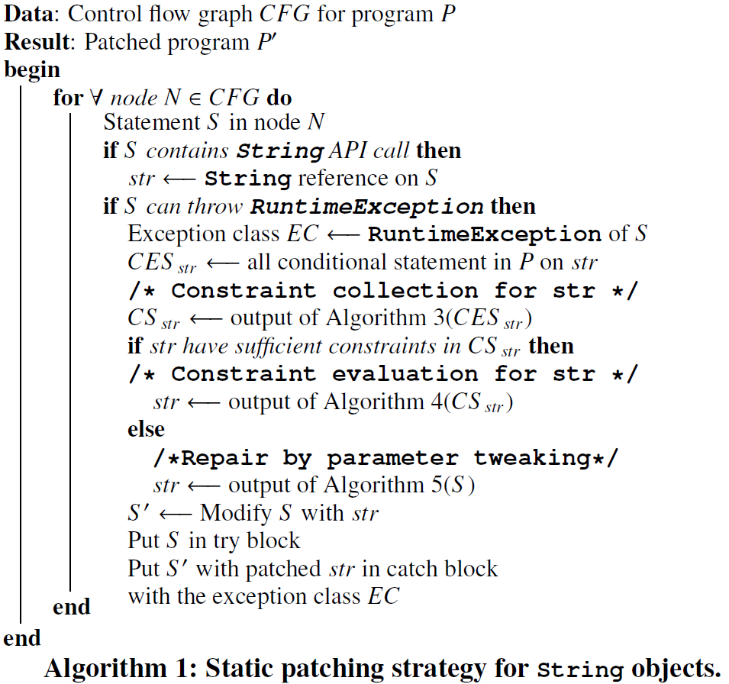
Static Patching Strategy

Slide 39
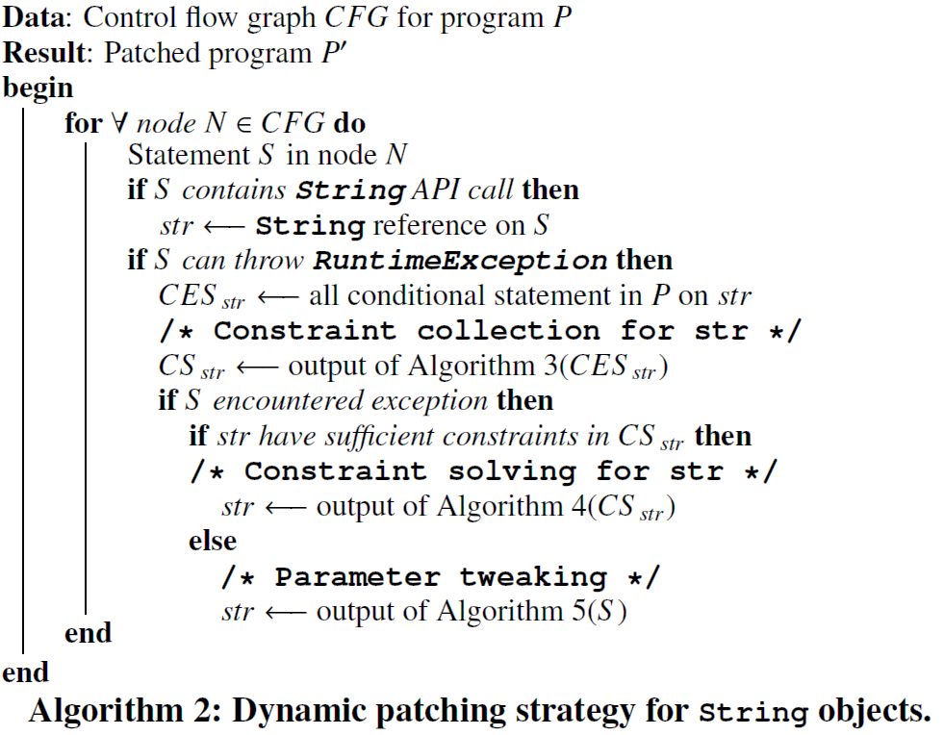
Dynamic Patching Strategy

Slide 40
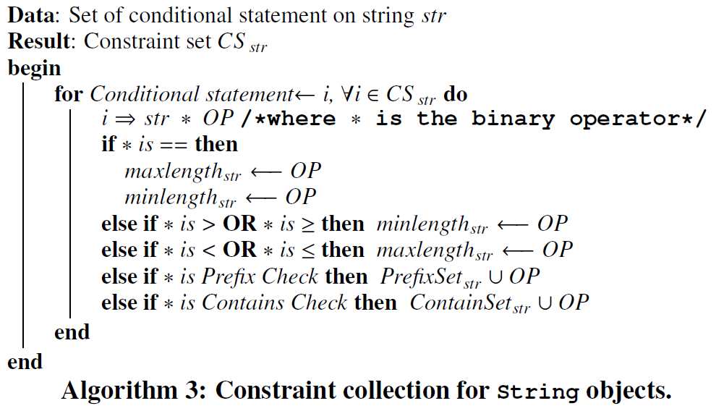
Constraint Collection

Slide 41
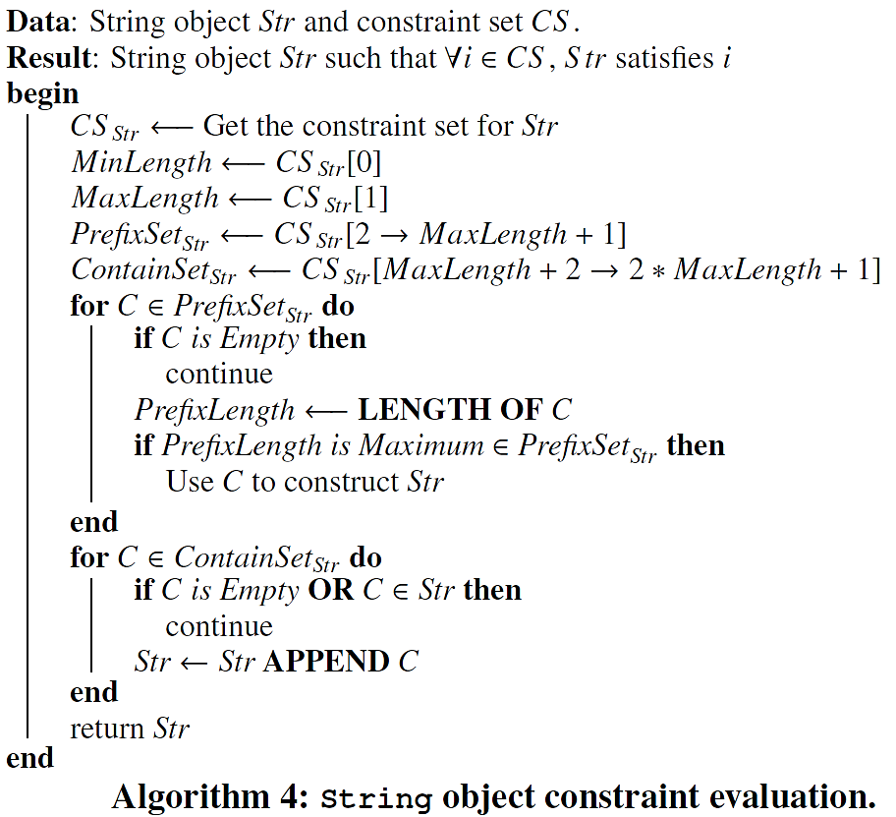
Constraint Evaluation

Slide 42
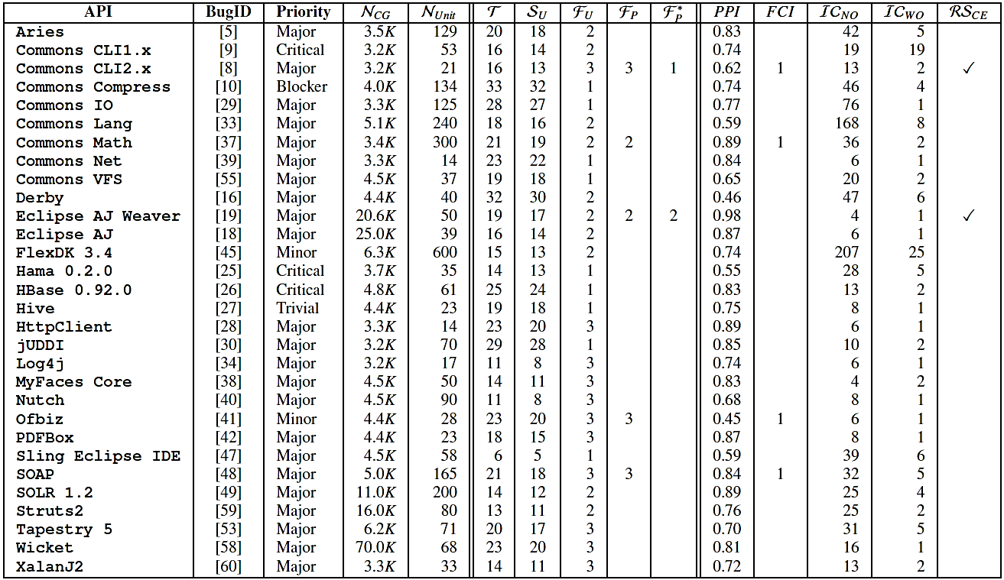
Clotho Evaluation

Slide 43
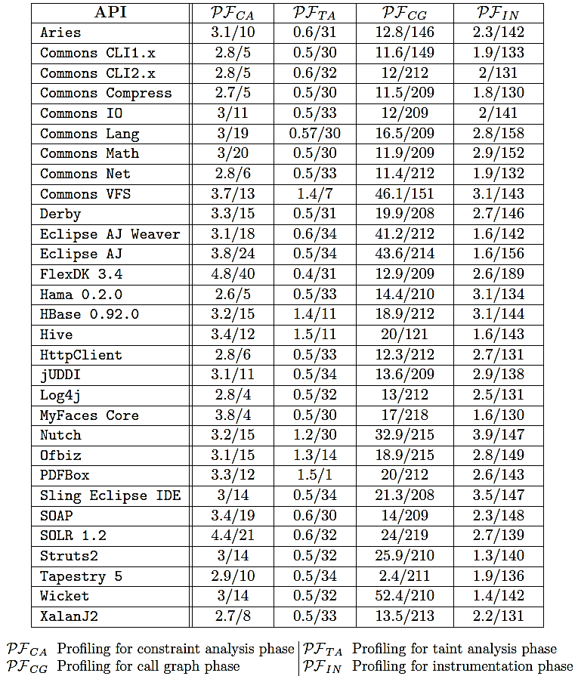
Clotho Performance

Slide 44
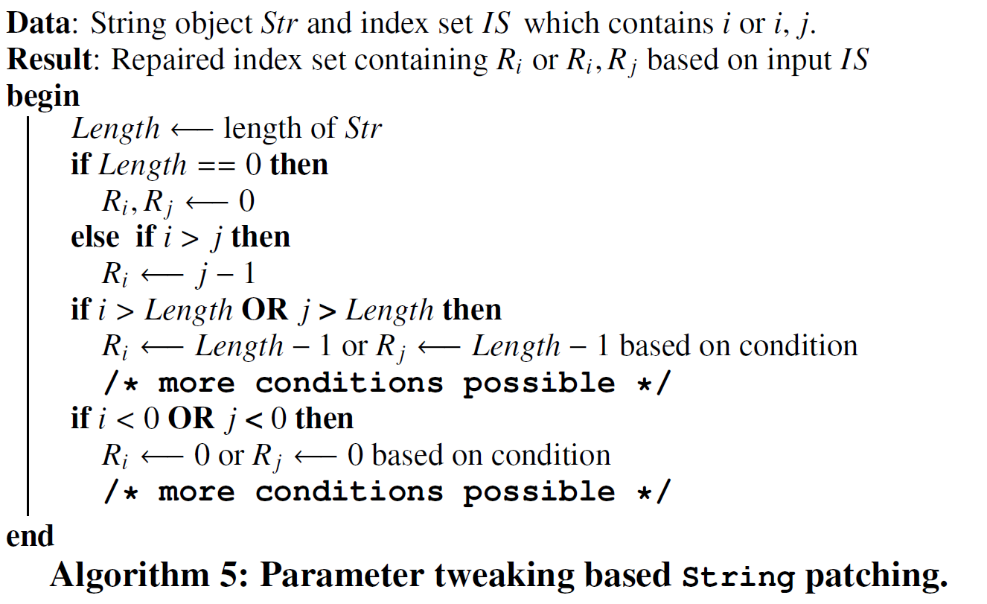
Fallback : Parameter Tweaking

